Slide 1
Model Training
Muhammad Umar
UIAI Lab

Slide 2
Contents
Linear Regression
Gradient Descent
Polynomial Regression
Learning Curve
Regularized Linear Models
Logistic Regression

Slide 3
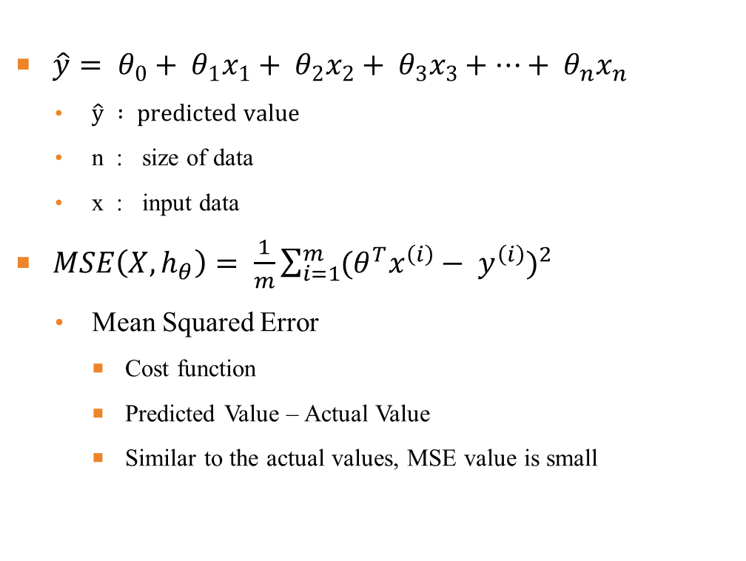
Linear
Regression
$\hat{y}= θ_{0}+ θ_{1}x_{1}+ θ_{2}x_{2}+ θ_{3}x_{3}+…+ θ_{n}x_{n}$
  $\hat{y} : predicted value$
  n : size of data
  x : input data
$MSE\left(X,h_{θ}\right)= \frac{1}{m}\sum_{i=1}^{m}{{(θ^{T}x^{\left(i\right)}− y^{\left(i\right)})}^{2}}$
  Mean Squared Error
    Cost function
    Predicted Value – Actual Value
    Similar to the actual values, MSE value is small

Slide 4
Gradient Descent and its types
Method to find local optima (maximum or minimum)
To adjust the parameters repeatedly to minimize the cost function
Gradient tells us direction of greatest increase
Learning step is learning rate
Cost
Cost
Types
Plateau
Batch Gradient Descent
Mini-Batch Gradient Descent
Stochastic Gradient Descent
Global minimum
Start
Local minimum
Figure: Learning Rate
Figure: Gradient Descent pitfalls

Slide 5
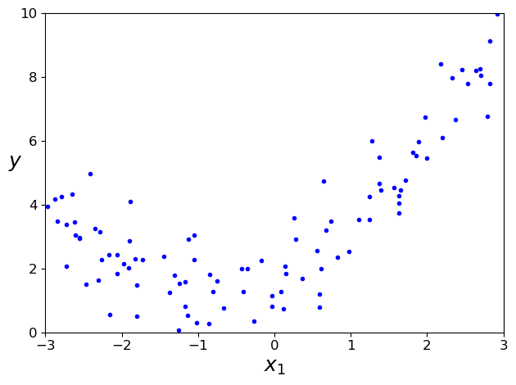
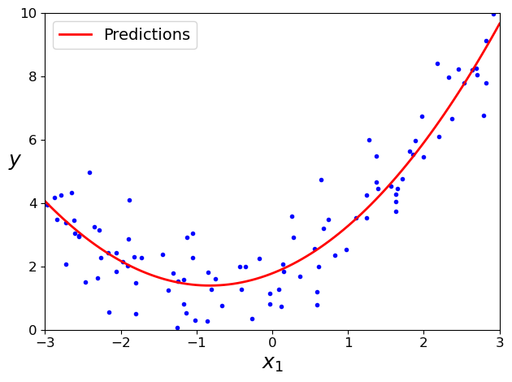
Polynomial Regression
Not linear, complex shape
Add the increments of each characteristics as a new characteristic
Train linear models on datasets with extended characteristics.
Figure: Non-Linear Dataset
Figure: Polynomial Regression Predictions

Slide 6
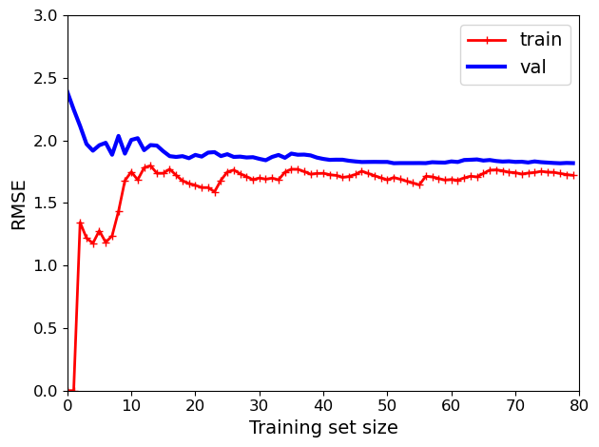
Learning curve
Learning curve shows how accuracy changes with varying sample size.
Make subset in training set and train several times.
Figure: Learning Curve

Slide 7
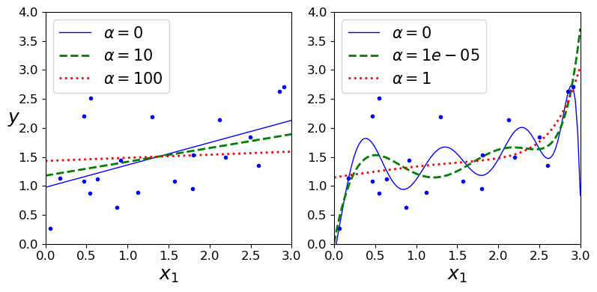
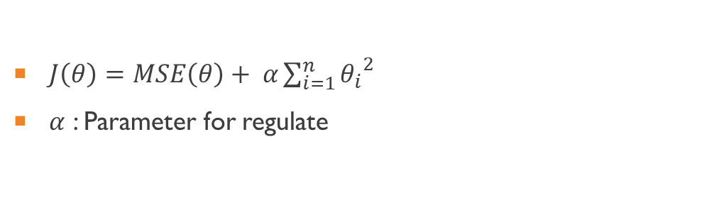
Regularized Linear models
$J\left(θ\right)=MSE\left(θ\right)+ α\sum_{i=1}^{n}{{θ_{i}}^{2}}$
$α$ : Parameter for regulate
Figure: Ridge Regularization
Notes:
Consider talking about:
Cybernetics and brain simulation
Symbolic
Sub-symbolic
Statistical learning
Integrating the approaches

Slide 8
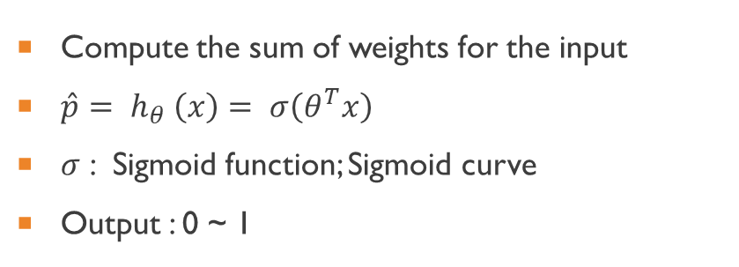

Logistic regression
Compute the sum of weights for the input
$\hat{p}= h_{θ} \left(x\right)= σ\left(θ^{T}x\right)$
$σ$ : Sigmoid function; Sigmoid curve
Output : 0 ~ 1
$$σ\left(t\right)= \frac{1}{1+e^{−t}}$$
Figure: Logistic function
Notes:
Consider talking about:
Search and optimization
Logic
Probabilistic methods for uncertain reasoning
Classifiers and statistical learning methods
Artificial neural networks
Evaluating progress

Slide 9
Thank You

